Slide 1


  3C2A CONFERENCE
  Dr. Ron Nocetti
  CIF Executive Director

Slide 3
CIF Mission
It’s bigger than sports. The CIF provides students with the opportunity to belong, connect and compete in education-based experiences.
Every student in California has the unique opportunity to participate and experience being a part of a school team or student organization. The CIF and our school communities support our students’ journeys by developing impactful relationships through transformational educators and coaches who provide a healthy environment for growth and development. It is essential to have families and community supporters who display positive behavior which will allow our students to create their own experiences.

Slide 4
The CIF is authorized by the California State Legislature and organized under the auspices of the California Department of Education to govern high school athletics (grades 9-12). The CIF is required to provide a comprehensive report of its activities to the Legislature every 7 years (most recently in February 2024).
1,243 public high schools
389 private high schools
1,836,000 million CIF Member School Students
806,000 students participate in sports (44%)
72,000 coaches (72% off-campus)

Slide 5
CIF Health and Safety
Development of Statewide Health and Safety Bylaws
  Heat Illness and Acclimatization
    WBGT and Heat Index
    Kestrel and Perry Weather
  EAP and AED
    Rehearsal of Plan
    AED within 3 minutes of all venues
  Air Quality Index
    151 or higher
    Measurement Device
ACL Injuries and Neuromuscular Training
  https://www.riipreps.com/

Slide 6
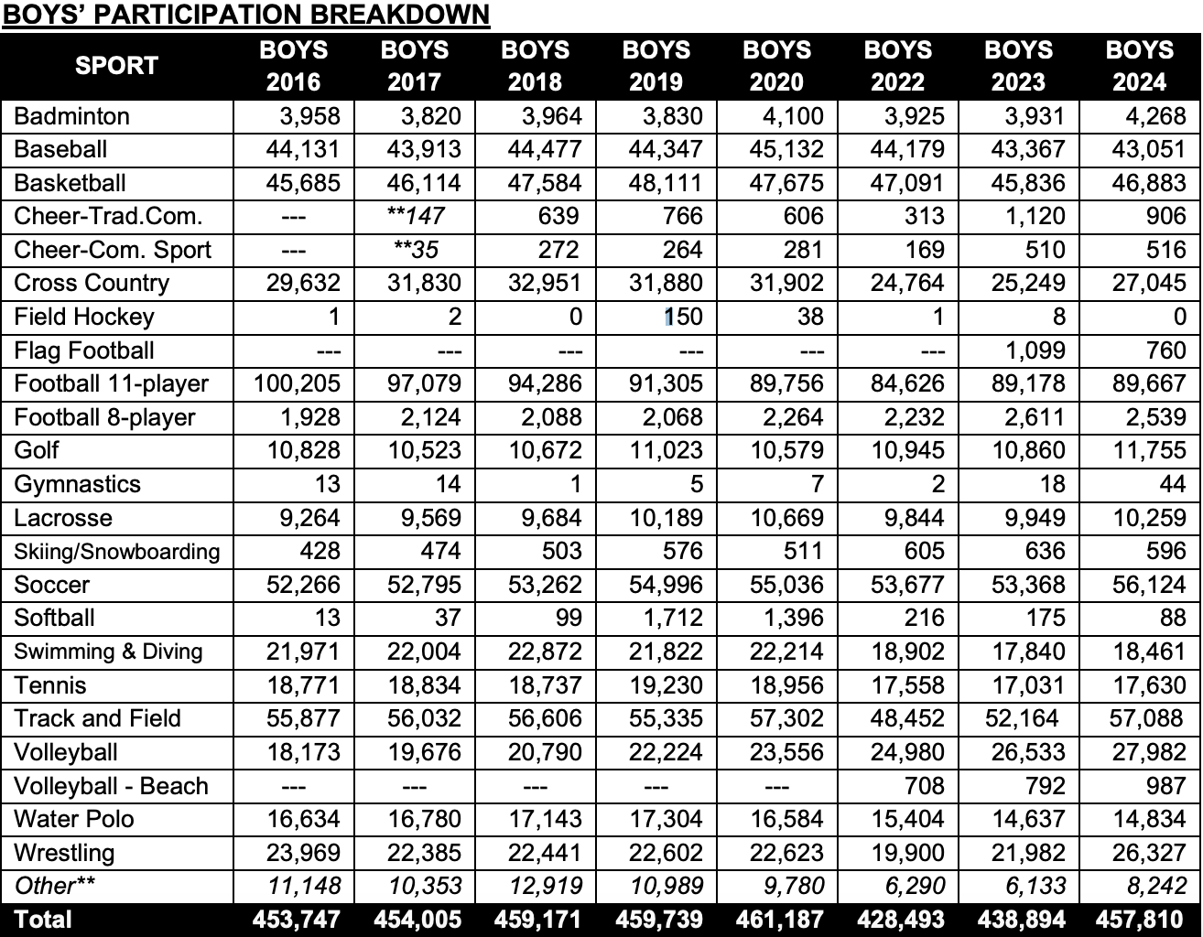
CIF Sport Participation - Boys

Slide 7
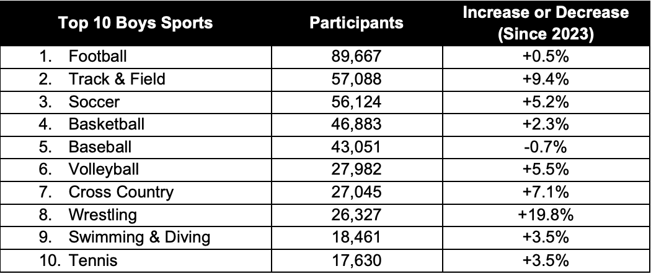
CIF Sport Participation - Boys

Slide 8
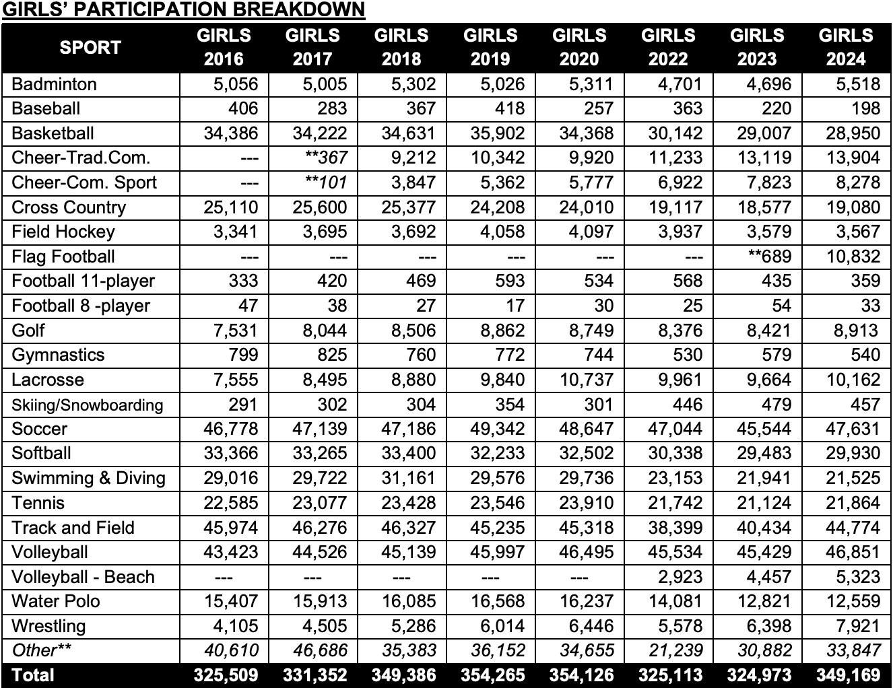
CIF Sport Participation - Girls

Slide 9
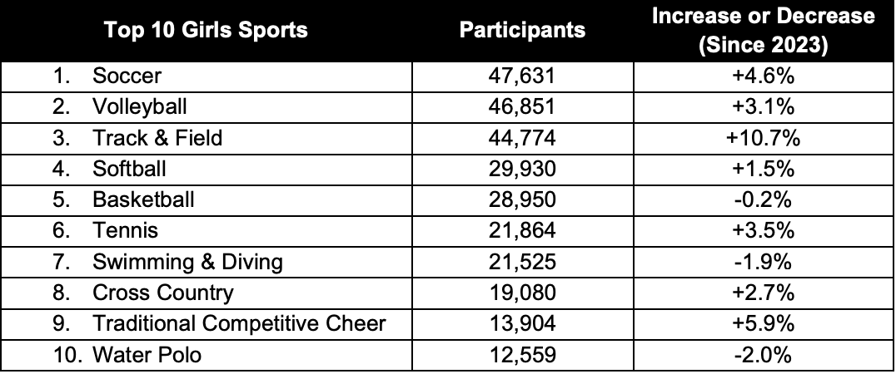
CIF Sport Participation - Girls

Slide 10
CIF Sport Offerings
Girls Flag Football Projections for 2025
  Over 700 schools
  Over 15,000 student-athletes
https://cifstate.org/coaches-admin/census/index

Slide 11
CIF and 3C2A - A Partnership
California Community College Alliance
  Presence at CIF Championship Events
  Social Media Branded Posts
  Vendor Booth Space
  Signage
  PA Reads
  Full Page Ad in Championship Programs
  Commercial Spots in Produced Events
  Email to Schools (Principal, AD, Coaches)

Slide 12
CIF and 3C2A - A Partnership
Strength – Participation Numbers
Weakness – Championship Facilities
Opportunity – Promotion of the 3C2A/New Sports
Threat – Lack of Officials; Education-Based Athletics

Slide 13
CIF and 3C2A - Facilities
What are the positive aspects of hosting CIF championships?
What are the barriers to hosting CIF championships?
What can the CIF do to remove/lessen these barriers?

Slide 14
Legislation
AB 437 (Lackey) - Health and Safety Reporting
AB 749 (McKinnor) - Youth Sports Commission
AB 89 (Sanchez) - Interscholastic Sports: Gender Equity
AB 844 (Essayli) – Sex Segregated Sports/Facilities
  Similar changes to higher education portion of ed code

Slide 15
CIF Commission for Strategic Priorities
Sportsmanship/Fan Behavior/Discriminatory Acts
  Support new language in Bylaw 503.M.
  Sportsmanship banner program
  Enhanced collaboration between coaches and officials through improved pre-game communication and post-game feedback
  Statewide Bylaw addressing “Court Storming”
Officials
  Continue Officials Appreciation weeks
  Registration and Background Check Program
  Work with 3C2A on possible officials courses
Equity
  Lack of Funding and Access
  Attract and Retain Female Coaches
  Band and Cheer and Girls Games

Slide 16
CIF Commission for Strategic Priorities
Mental/Physical Health of Student-Athletes
  The committee proposed over 12 potential topics for the "Monthly Mental Health Minute" Initiative
  Developing strategies to assist coaches in recognizing mental health triggers related to injuries, try-outs, postseason pressures, and finals/exams
  Strategies for ensuring student access to resources
Athletic Trainers
  Risks of not having an ATC v. Benefits of having an ATC
  Staffing an ATC (availability, hiring/funding mechanisms, partnerships)
  ATC requirements at “high risk/contact” sports

Slide 17
CIF Commission for Strategic Priorities
Championship Events/Competitive Equity
  Pre-Playoff Zoom meeting for all teams
  GameDay Manual
  Visiting Team Game Operations Information
  Sportsmanship PA Announcement
  Sections design their playoffs to meet the needs of their member schools
  Sections rank, in order of strength, their qualified teams
  State ranks all qualified teams in order of strength
    Rankings: Win/loss percentage; Strength of schedule; History

Slide 18
CIF Commission for Strategic Priorities
Transfer Eligibility/Appeals
  First Time Transfer
  Transferring after first move
  Changes to the Sit Out Period
  Meeting with schools with multiple transfers

Slide 19
CIF Leadership Initiative
Resources for Schools and School Districts
https://cifstate.org/governance/leadership/index

Slide 20
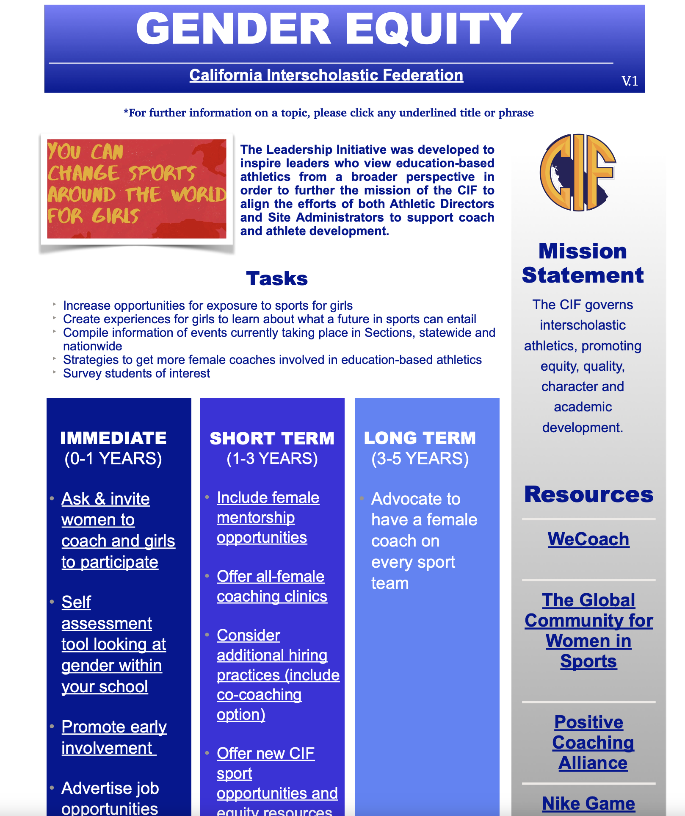

Slide 21
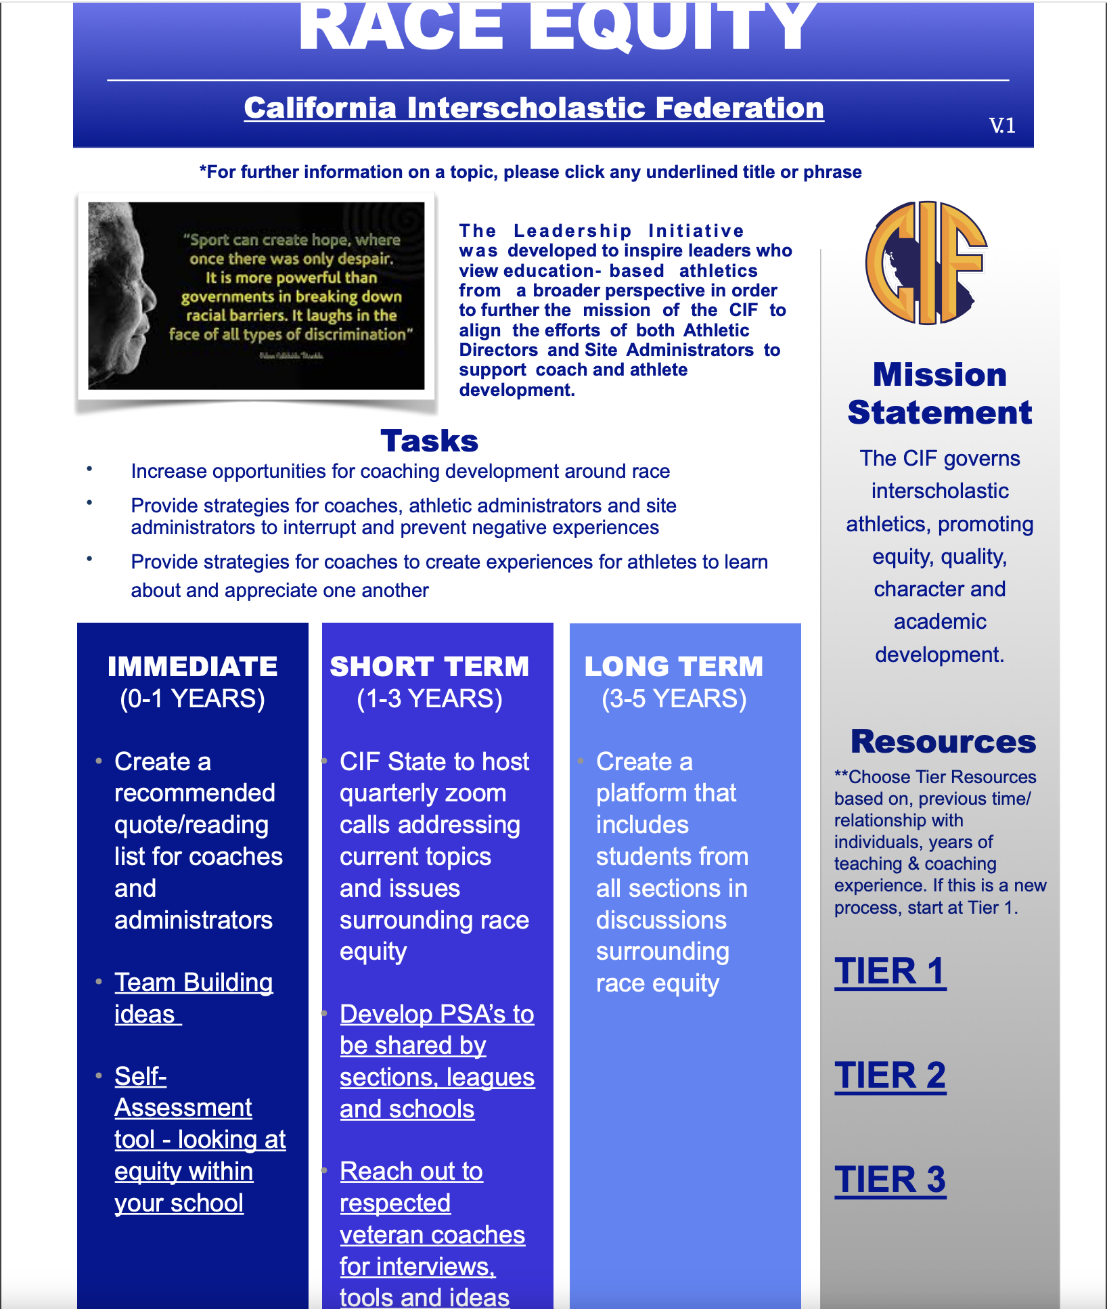

Slide 22
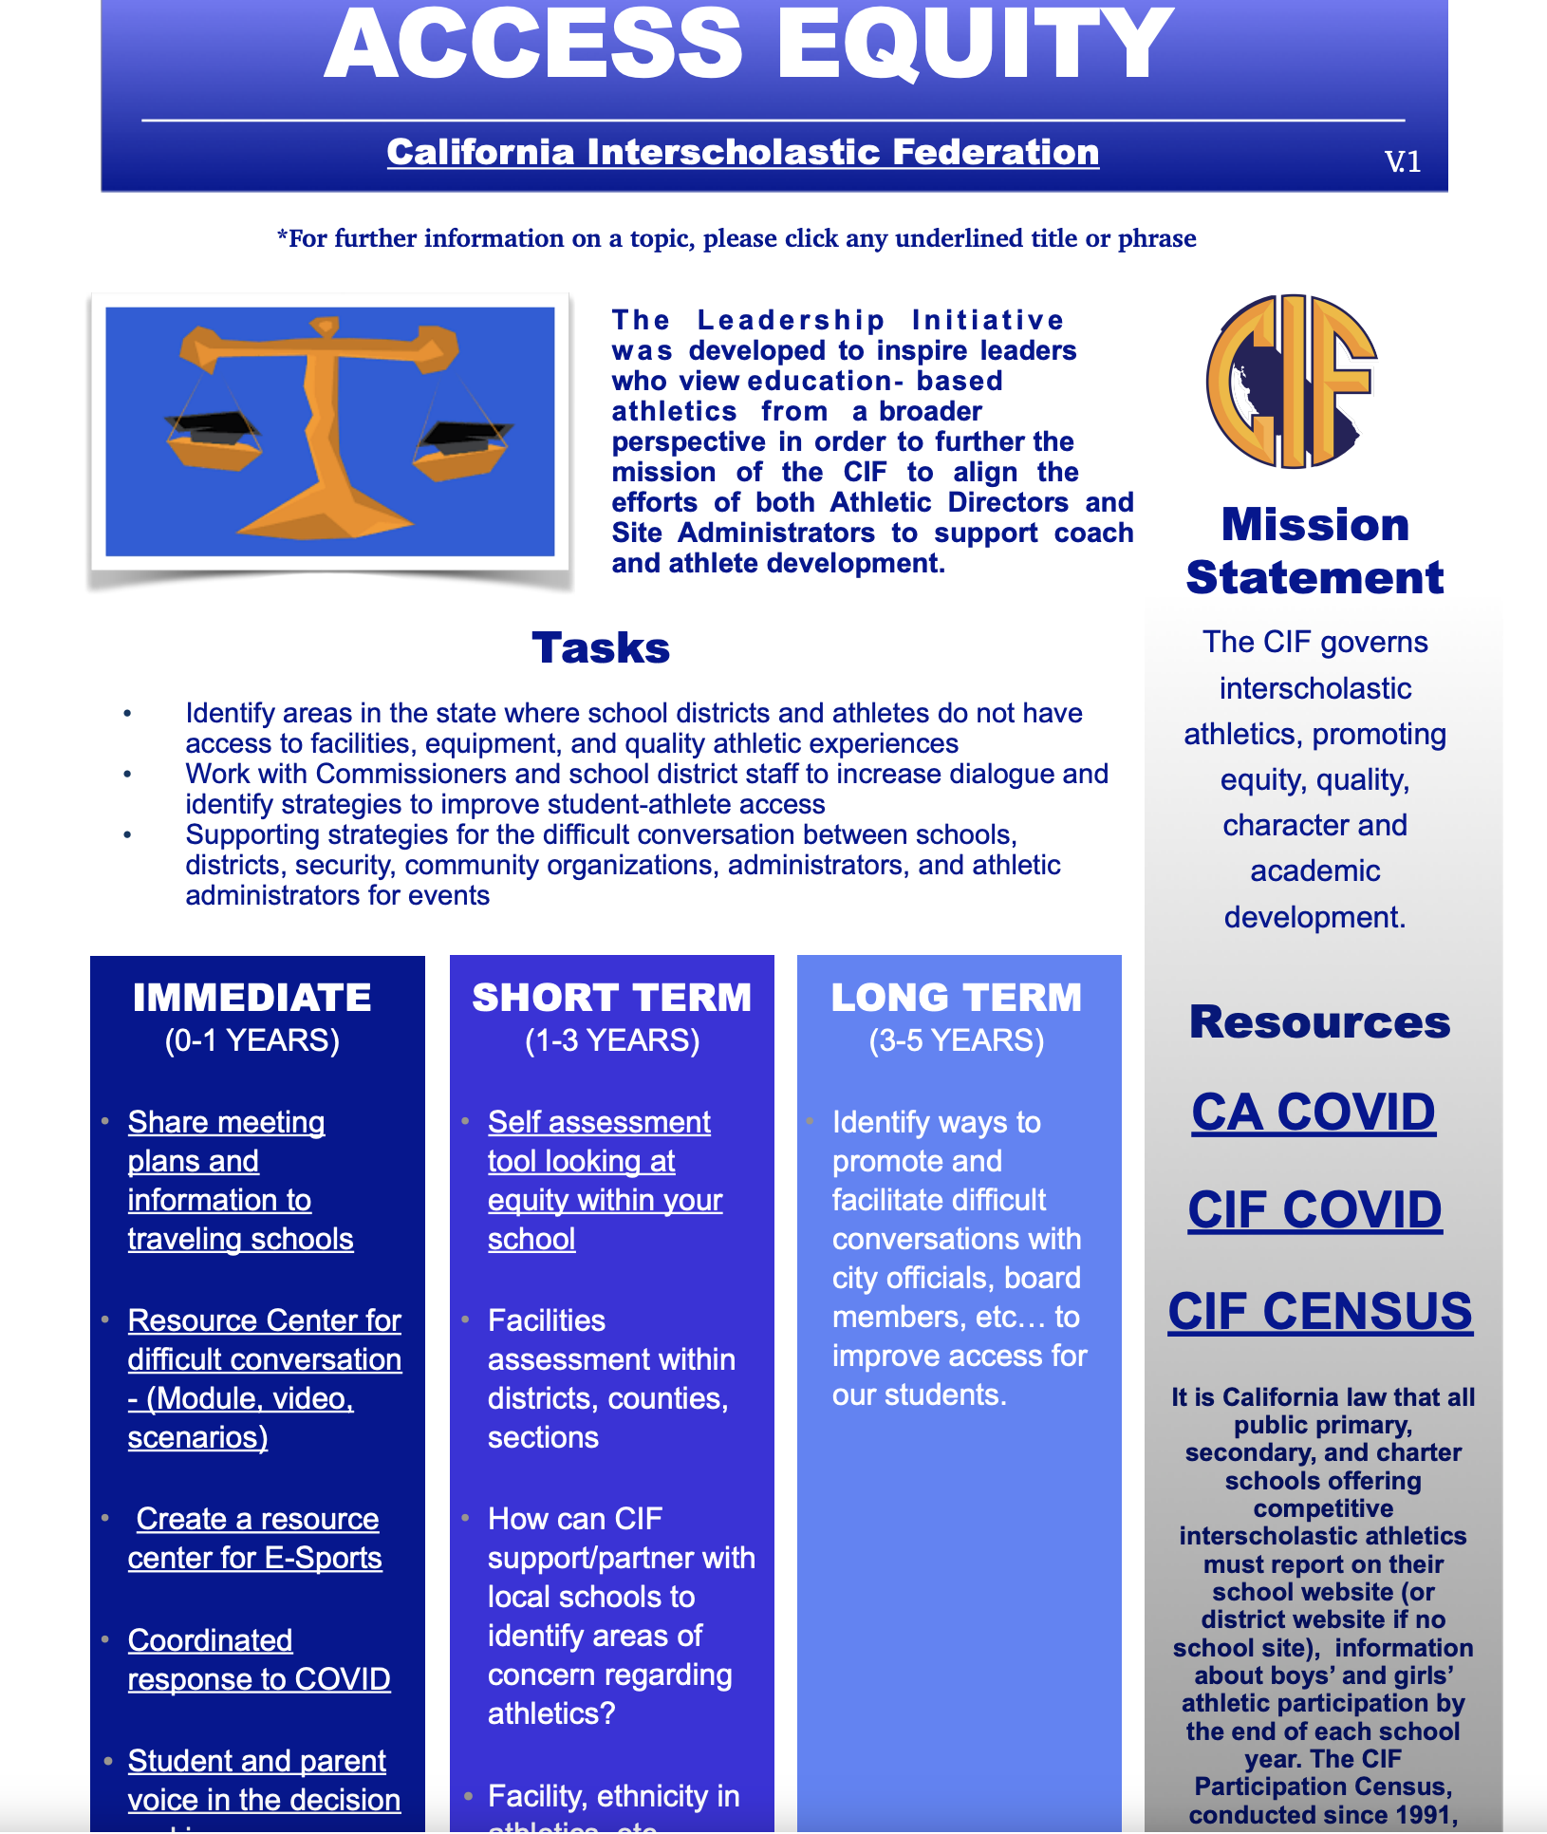

Slide 23


Slide 24
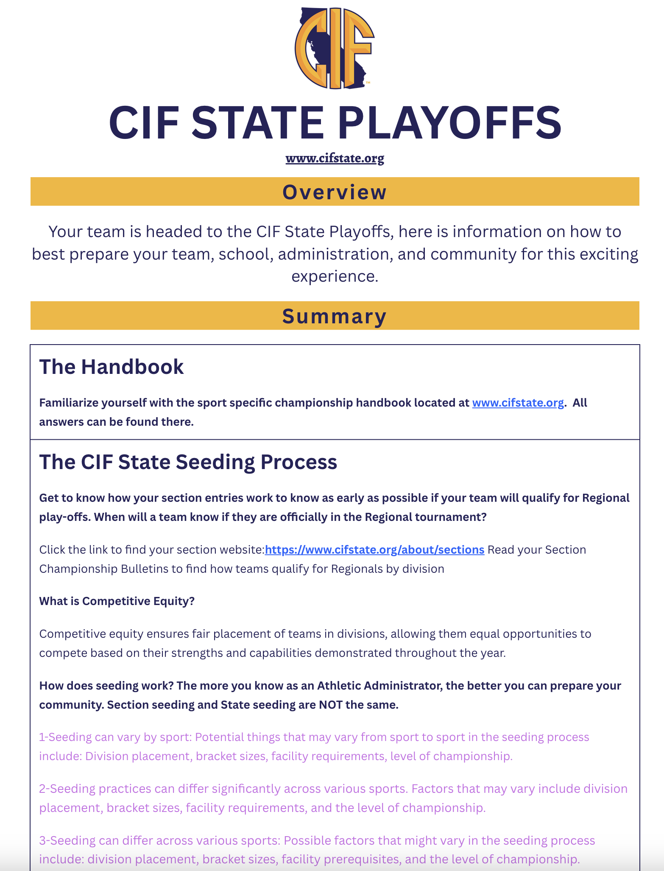

Slide 25

CIF Unified/Paralympic Sports

Slide 26
How Can we Help?
www.cifstate.org

